Slide 1
Predictive Analytics In Healthcare

Slide 2
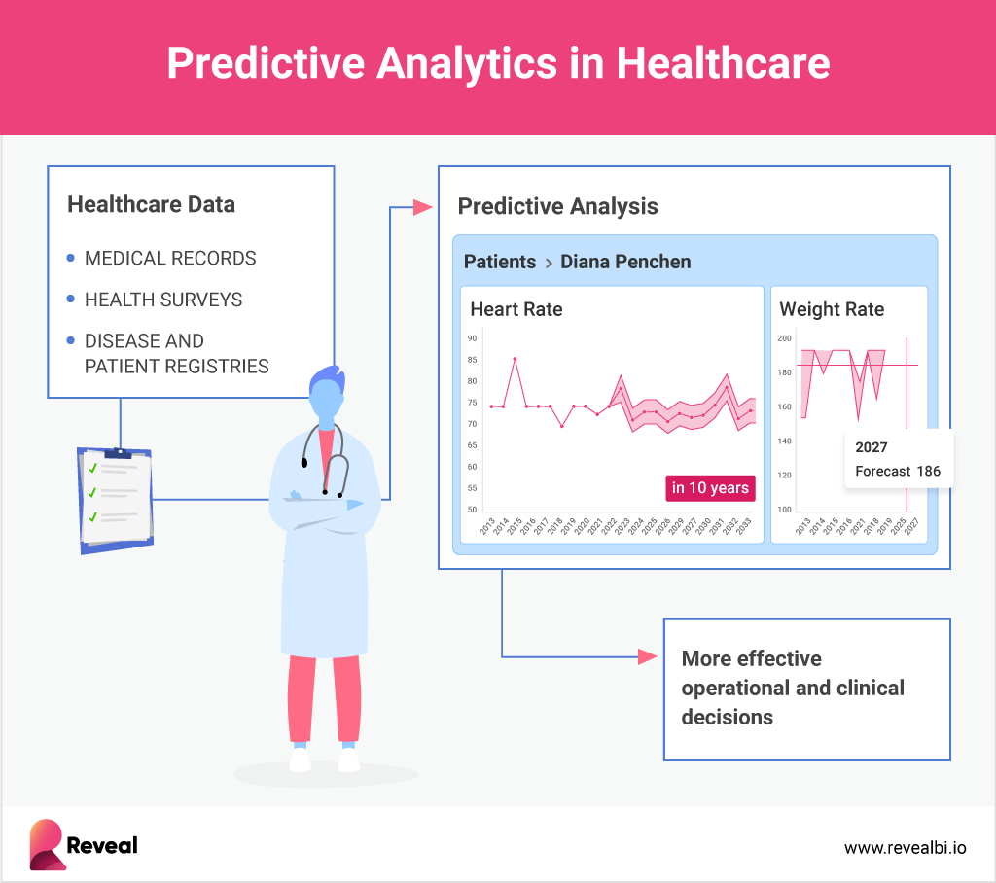
Introduction to Predictive Analytics in Healthcare
Predictive analytics involves using historical data and statistical algorithms to forecast future outcomes.
In healthcare, this can lead to improved patient care, operational efficiency, and cost reduction.
Notes:
Image source: https://www.revealbi.io/blog/predictive-analytics-in-healthcare

Slide 3
Importance of Data in Predictive Analytics
High-quality data is crucial for accurate predictions and effective decision-making.
Various sources, including electronic health records (EHRs) and wearables devices, provide valuable data inputs.
Notes:
Image source: https://www.vrogue.co/post/the-importance-of-data-collection-10-reasons-why-data-is-so-important

Slide 4

Applications in Patient Care
Predictive analytics can identify patients at risk for chronic diseases or hospital readmissions.
Optimizing treatment plans based on predictive models
Early identification allows for timely interventions and personalized healthcare strategies.
Notes:
Image source: https://www.philips.com/a-w/about/news/archive/features/20200604-predictive-analytics-in-healthcare-three-real-world-examples.html

Slide 5
Operational Efficiency and Resource Management
Predictive analytics helps healthcare organizations optimize staffing and resource allocation.
By forecasting patient volumes, hospitals can better manage their operational workflows.
Notes:
Image source: https://www.revealbi.io/blog/predictive-analytics-in-healthcare

Slide 6
Enhancing Clinical Decision Support Systems
Predictive models can assist clinicians in making more informed treatment decisions.
They provide evidence-based recommendations tailored to individual patient profiles.
Notes:
Image source: https://www.researchgate.net/figure/Analytic-framework-CDSS-clinical-decision-support-system-CPGs-clinical-practice_fig1_357260672

Slide 7
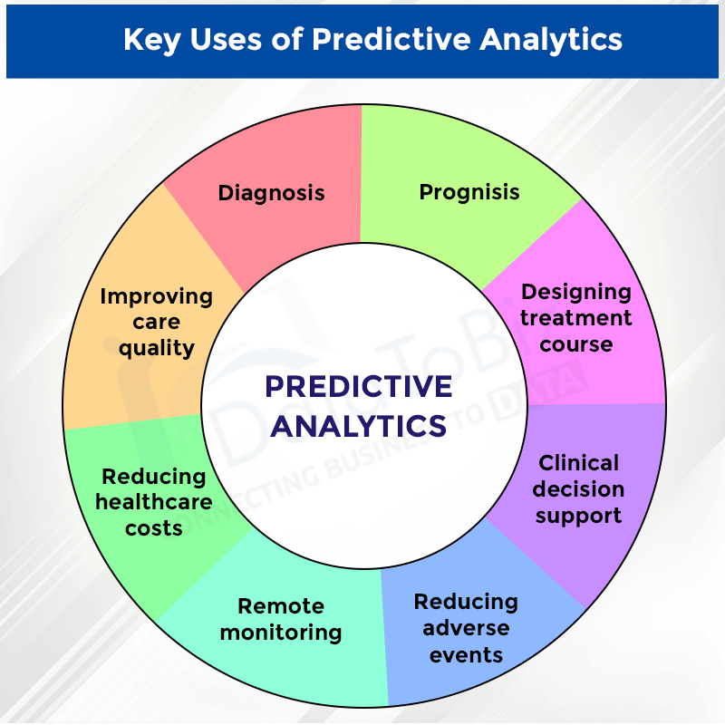
Predictive Analytics in Public Health
Public health agencies use predictive analytics to forecast disease outbreaks and trends.
This can facilitate timely interventions and resource allocation during public health emergencies.
Notes:
Image source: https://www.datatobiz.com/blog/predictive-analytics-in-healthcare/

Slide 8
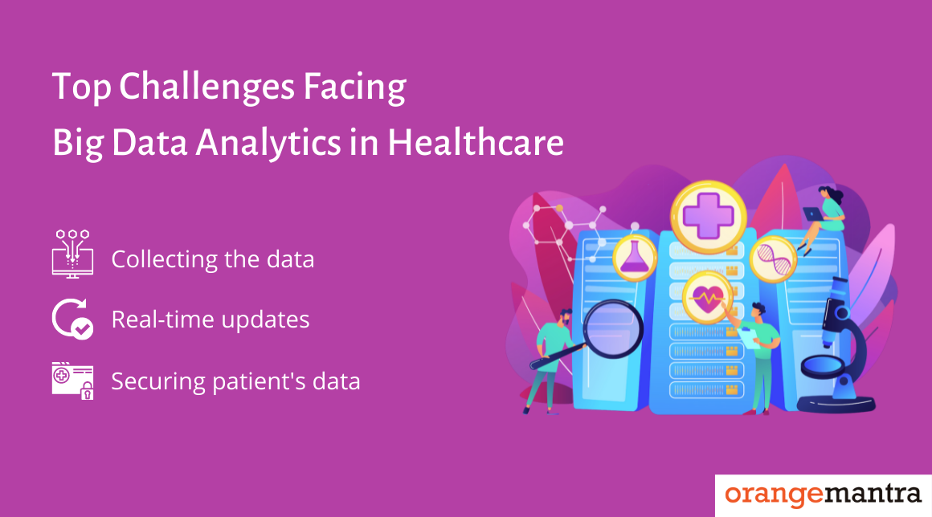
Challenges in Implementing Predictive Analytics
Data privacy and security concerns pose significant challenges in healthcare analytics.
There is often a lack of standardization in data formats, hindering effective analysis.
Notes:
Image source: https://www.orangemantra.com/blog/top-challenges-facing-big-data-analytics-in-healthcare/

Slide 9
Future Trends in Predictive Analytics
Real-time data analysis will allow for dynamic and adaptive healthcare solutions.
Integration with electronic health records (EHRs)
Real-time predictive analytics.
Personalized medicine
Notes:
Image source: https://www.researchgate.net/figure/Evolution-of-Predictive-Analytics_fig1_323116271

Slide 10
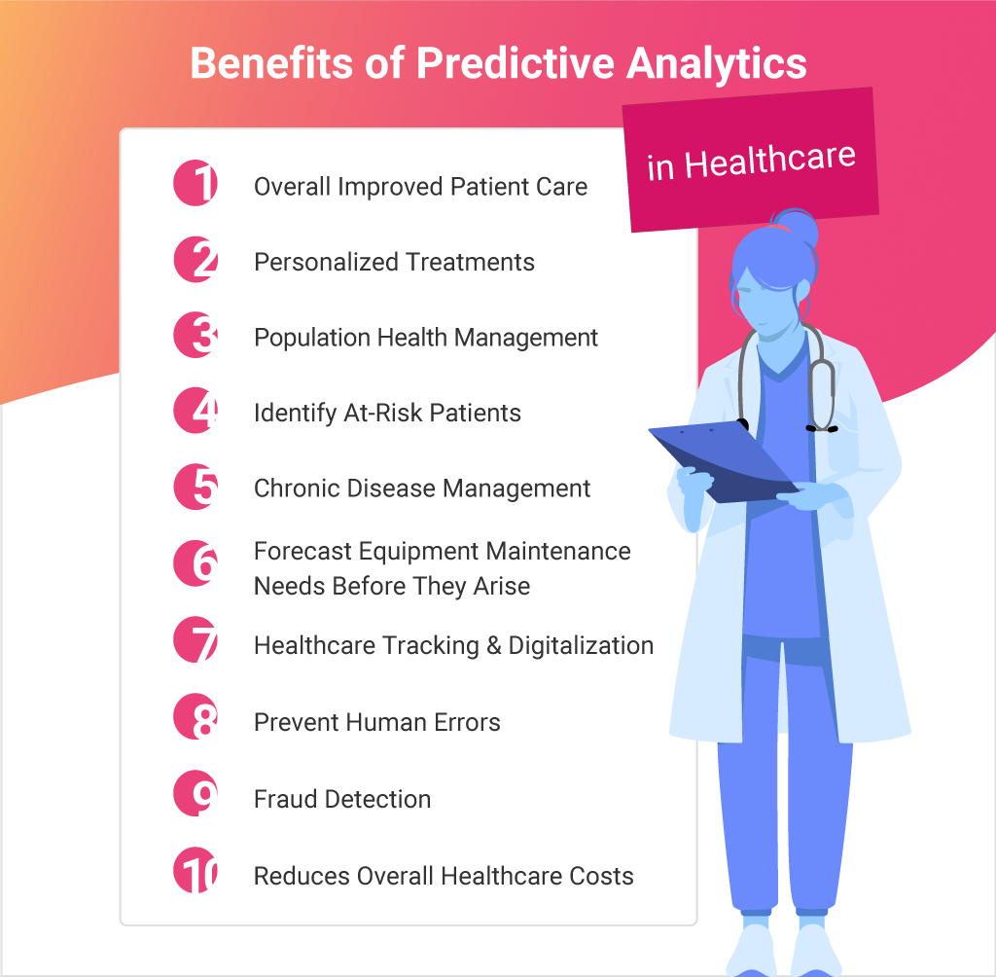
Conclusion
Embracing predictive analytics can lead to significant advancements in healthcare delivery.
This project will demonstrate the practical application of data science in solving real-world healthcare problems.
Notes:
Image source: https://www.revealbi.io/blog/predictive-analytics-in-healthcare

Slide 11
Thank You…!!!
Notes:
Image source: https://risemrktg.com/portfolio-2/case-studies-and-success-stories/

